Slide 1
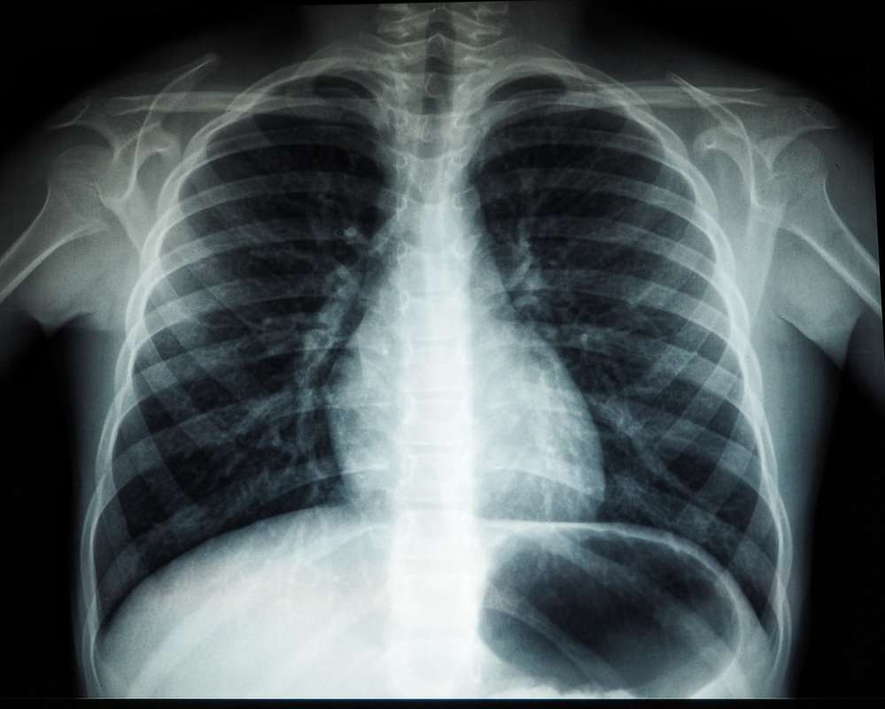
BY: Med-X (Team 1)
CS691
February 2024
Notes:
Do not delete this slide. It is a part of the animation for the 2nd page.

Slide 2
BY: Med-X (Team 1)
CS691
February 2024

Slide 3

AGENDA:
01
02
03
04
05
Our Team:
Member Names
Roles and Responsibilities
Project Overview:
Problem Statement
Project Description
Personas
Product Idea
Languages and Tools:
A list and explanation of technologies and algorithms used to complete the project
Team Logistics:
Project Schedule
Team Working Agreement
Retrospective:
What went well
What needs to be Improved
Action Items

Slide 4
AGENDA:
01
02
03
04
05
Our Team:
Member Names
Roles and Responsibilities
Project Overview:
Problem Statement
Project Description
Personas
Product Idea
Languages and Tools:
A list and explanation of technologies and algorithms used to complete the project
Team Logistics:
Project Schedule
Team Working Agreement
Retrospective:
What went well
What needs to be Improved
Action Items

Slide 5
AGENDA:
01
02
03
04
05
Our Team:
Member Names
Roles and Responsibilities
Project Overview:
Problem Statement
Project Description
Personas
Product Idea
Languages and Tools:
A list and explanation of technologies and algorithms used to complete the project
Team Logistics:
Project Schedule
Team Working Agreement
Retrospective:
What went well
What needs to be Improved
Action Items

Slide 6
AGENDA:
01
02
03
04
05
Our Team:
Member Names
Roles and Responsibilities
Project Overview:
Problem Statement
Project Description
Personas
Product Idea
Languages and Tools:
A list and explanation of technologies and algorithms used to complete the project
Team Logistics:
Project Schedule
Team Working Agreement
Retrospective:
What went well
What needs to be Improved
Action Items

Slide 7
AGENDA:
01
02
03
04
05
Our Team:
Member Names
Roles and Responsibilities
Project Overview:
Problem Statement
Project Description
Personas
Product Idea
Languages and Tools:
A list and explanation of technologies and algorithms used to complete the project
Team Logistics:
Project Schedule
Team Working Agreement
Retrospective:
What went well
What needs to be Improved
Action Items

Slide 8
AGENDA:
01
02
03
04
05
Our Team:
Member Names
Roles and Responsibilities
Project Overview:
Problem Statement
Project Description
Personas
Product Idea
Languages and Tools:
A list and explanation of technologies and algorithms used to complete the project
Team Logistics:
Project Schedule
Team Working Agreement
Retrospective:
What went well
What needs to be Improved
Action Items

Slide 9
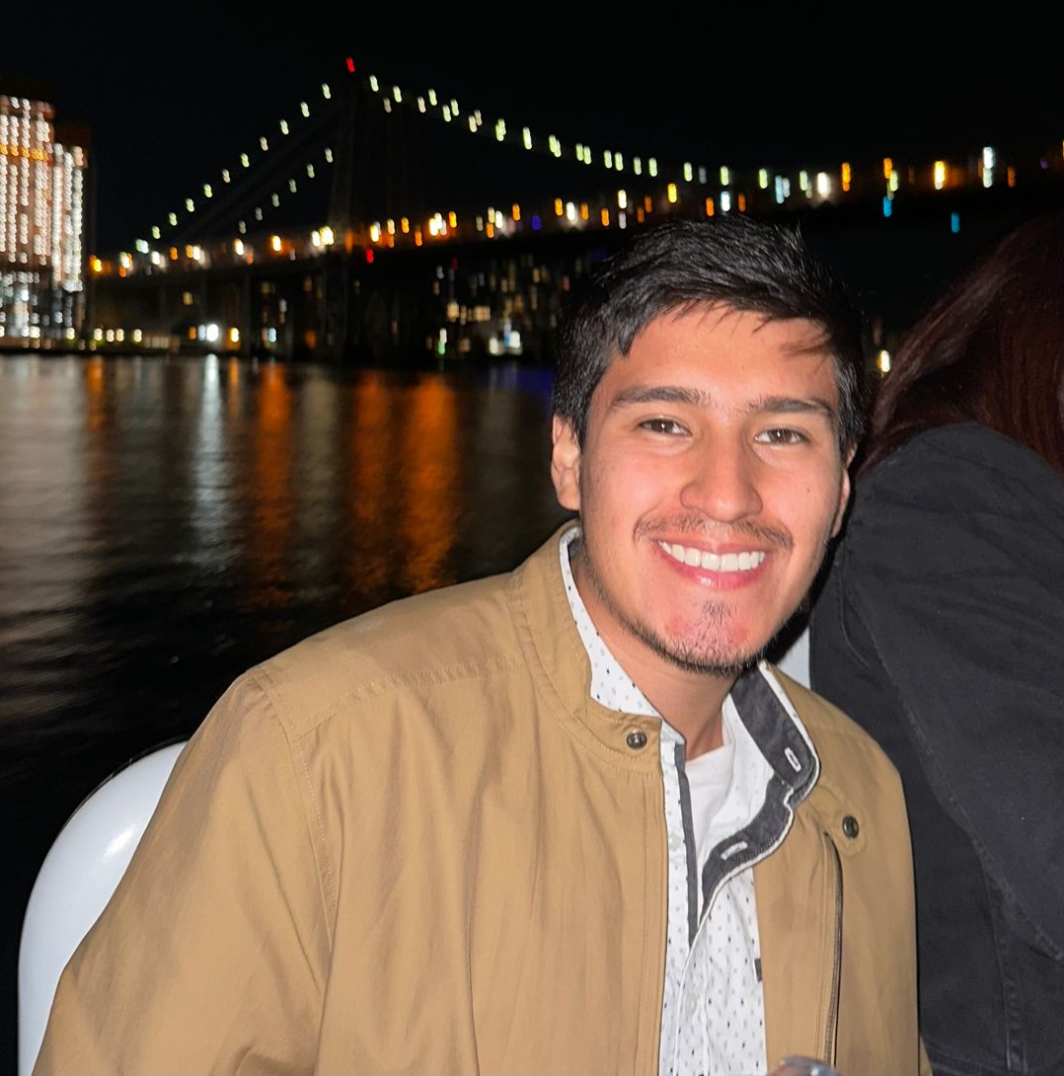
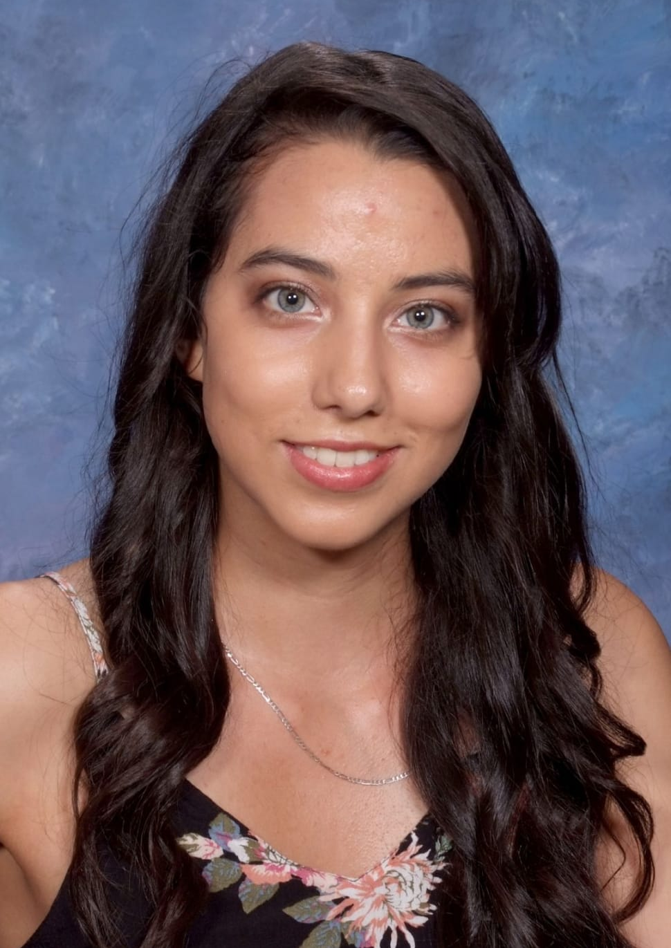
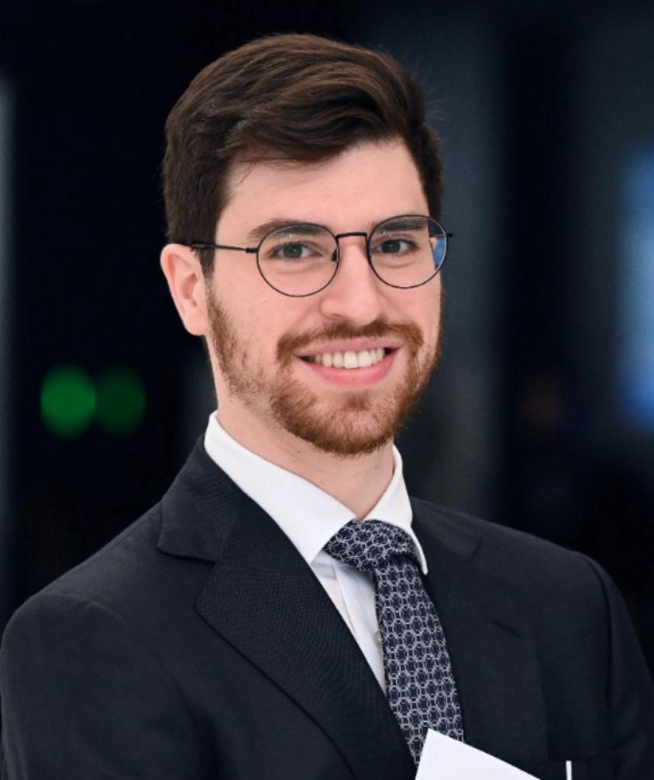
Team Roles and Responsibilities
Ronaldo Simbaña
Scrum Master
Marla Capistran
Team Leader
Filippo Zallocco
Developer

Slide 10
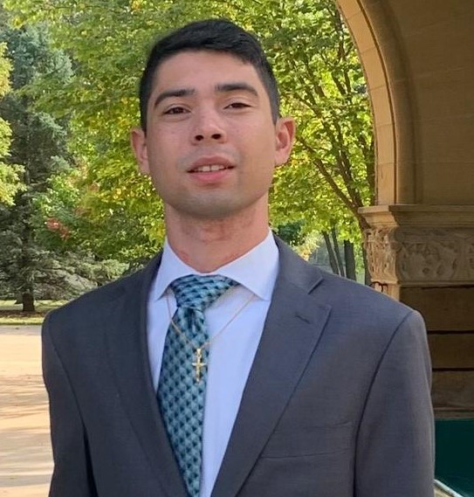
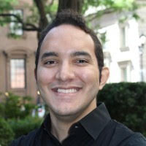
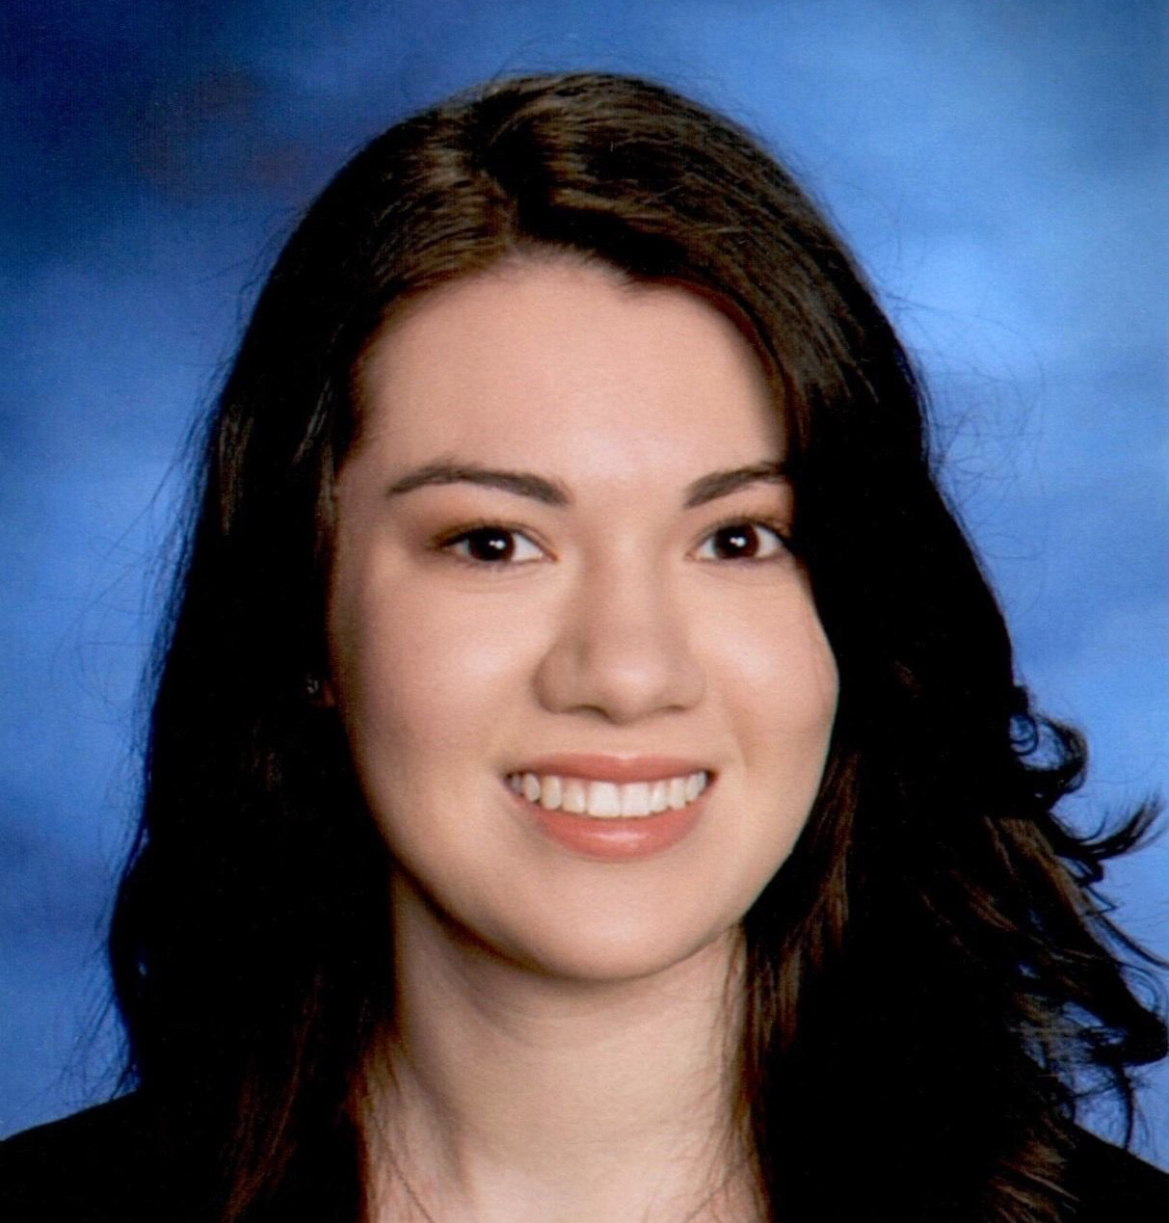
Team Roles and Responsibilities
Christopher Ospina
Developer
Anthony Muñoz
Quality Assurance / Tester
Leanna Machado
Developer

Slide 11
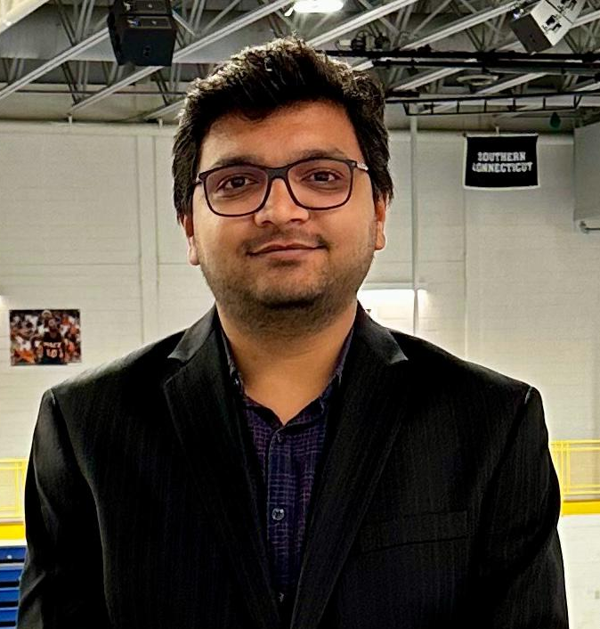
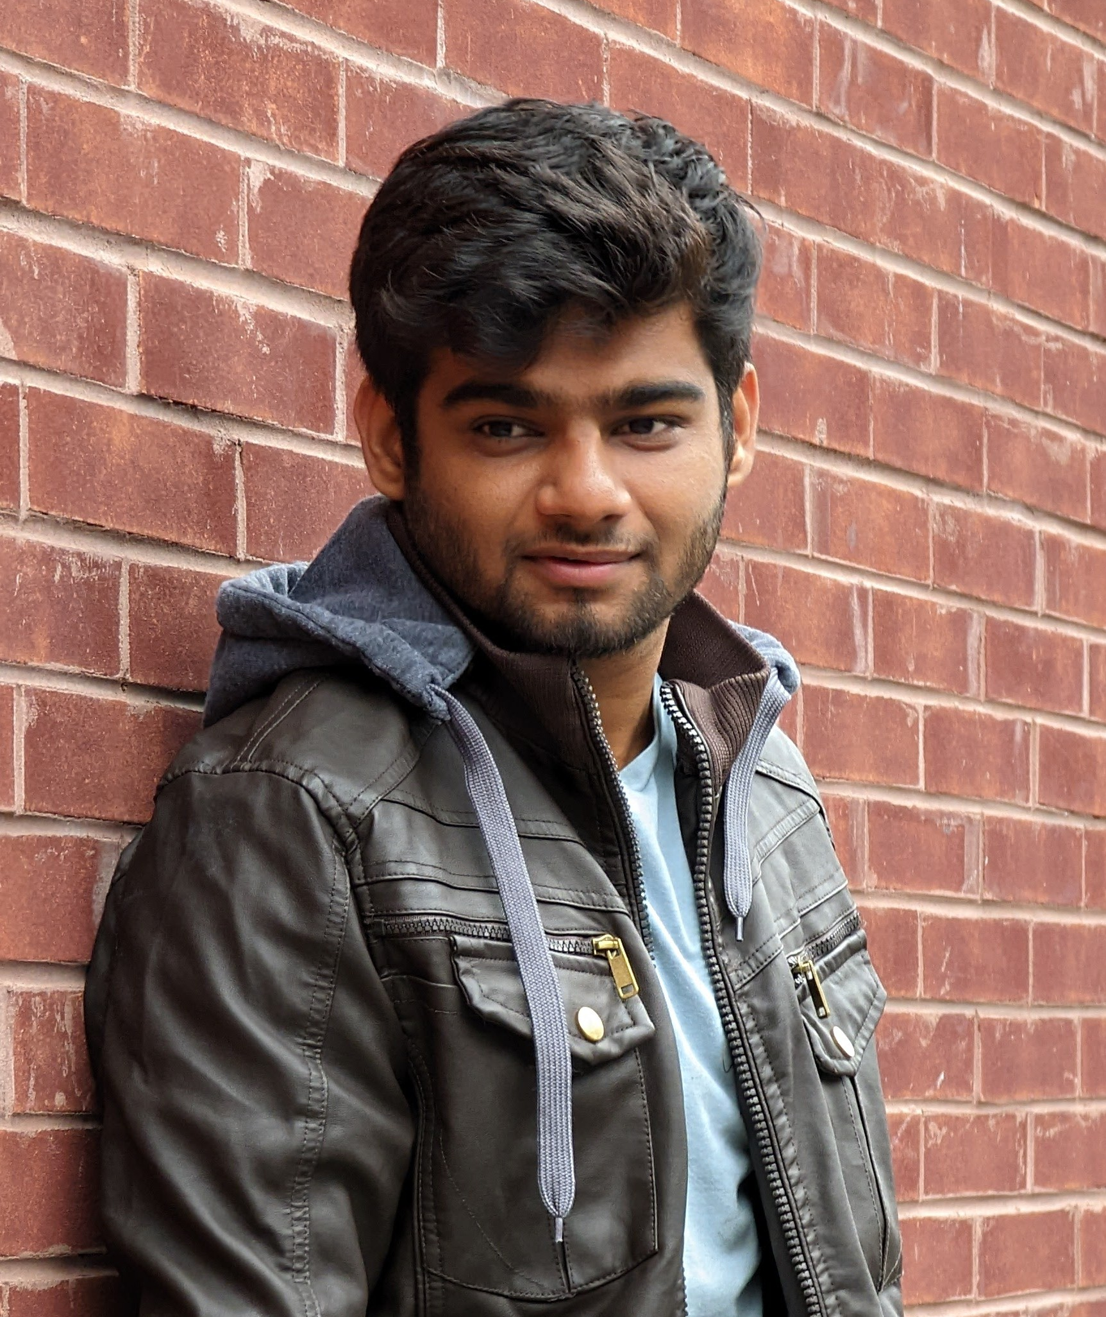
Team Roles and Responsibilities
Rahul Nayanegali
Developer
Prithvi Raimangya
Product Designer / Developer

Slide 12
Problem Statement
Currently, x-ray machines are widely available; however, clinical chest x-ray images can be challenging to read and diagnose. Furthermore, x-rays are not a priority for radiologists, as they tend to focus more on CT images and MRIs. CT scans are both harmful and expensive, in addition to being time consuming.

Slide 13
Project Description
A web app that has a highly trained deep learning model that classifies x-ray images, reducing the need for a radiologist to examine them
Intended for medical professionals and patients who upload x-ray chest images
Uses a deep-neural network model that will detect common chest health issues
Our application will reduce the time it takes for a patient to receive their diagnosis using AI
Notes:
We could mention that x-rays are comparatively less hazardous, less expensive, and less time-consuming than CT scan images.

Slide 14
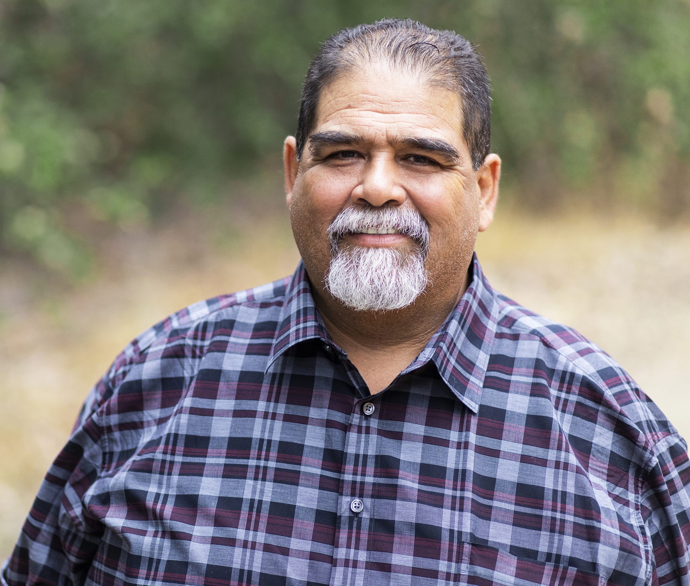
Patient Persona
Harold Castillo
Age: 55
Gender: Male
Occupation: Restaurant Owner
Location: Red Bank, NJ
Harold gets regular check-ups for a man his age but has trouble scheduling due to his job. It’d be great if he could just view his results and get an idea of what they mean and potential next steps without having to keep going in person.
Goals
View reports/results online
Able to connect with doctor about results online
Simple site for ease of use
Challenges
Making it to follow-ups for results
Understanding the results, even after a consultation
Time taken to receive results

Slide 15

Radiologist Persona
Sandro Cuccigno
Age: 50
Gender: Male
Occupation: Radiologist
Location: Manhattan, NY
Hospital: NYU Langone Medical Center
Has been in the practice for 20 years. His team is understaffed and under equipped. Is often exhausted from reviewing x-rays and informing people they have a serious illness.
Goals
Process chest images fast
Help hospital tend to patients
Improve workflow for his team
Challenges
Increasing patient volumes
Burnout from long shift and nature of the job
Facility cutting funds
Spends many hours reviewing x-rays

Slide 16
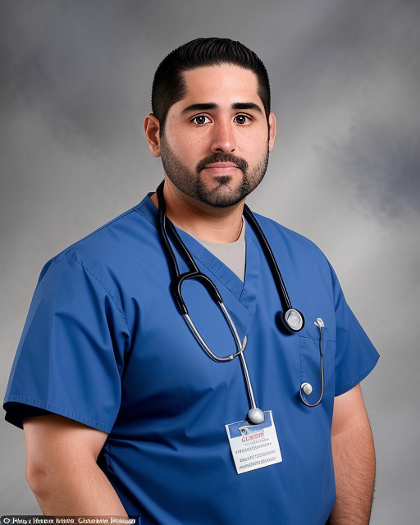
Doctor Persona
Dr. Bryce Ruiz
Age: 34
Gender: Male
Occupation: Doctor
Location: Fresno, Ca
Hospital: Albuquerque Medical Center
A 34-year-old medical professional from Fresno. Has been working at Albuquerque for over 10 years and has recently been promoted to Cardiology to conduct x-rays
Goals
Build a strong reputation with patients
Explain to patients what they have in a clear manner
Challenges
Large volume of patients
Limited time for consultations
Patients are often confused about their diagnosis

Slide 17
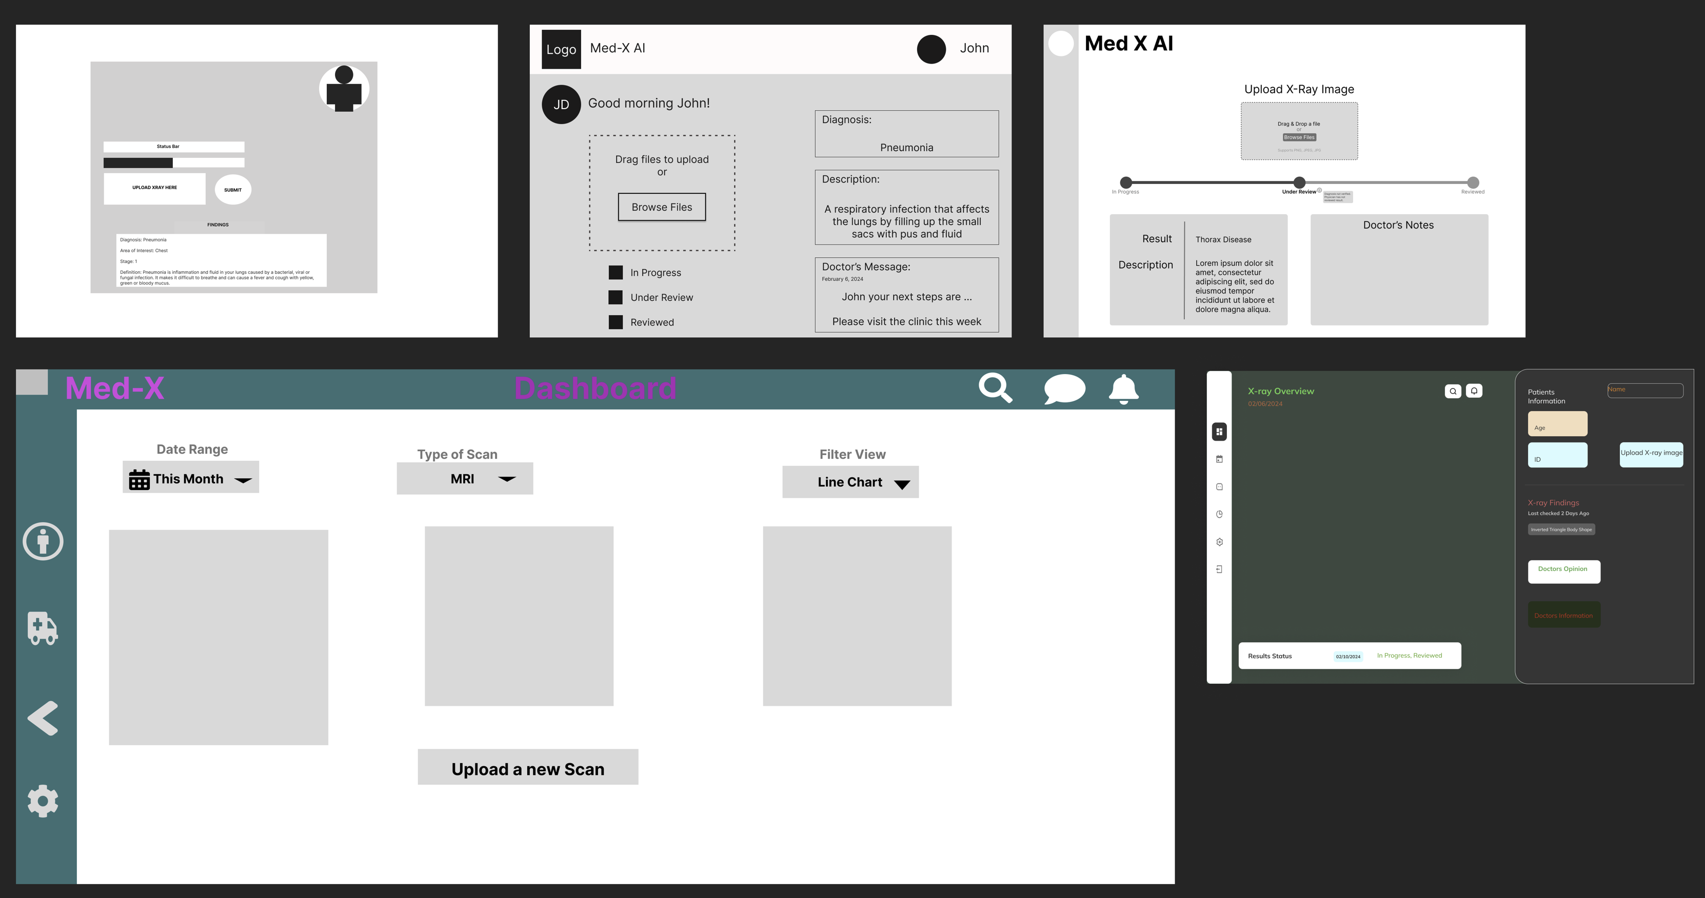
Product Design Journey

Slide 18
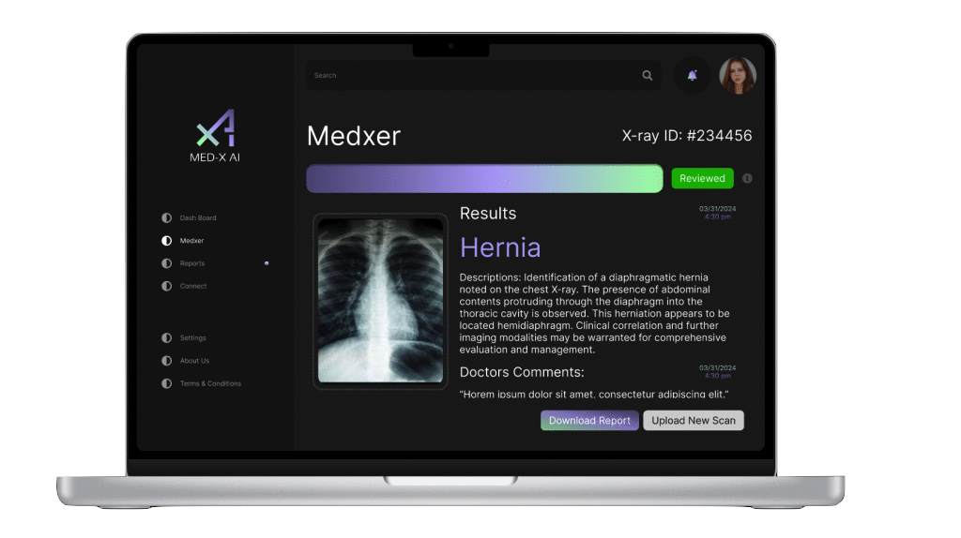
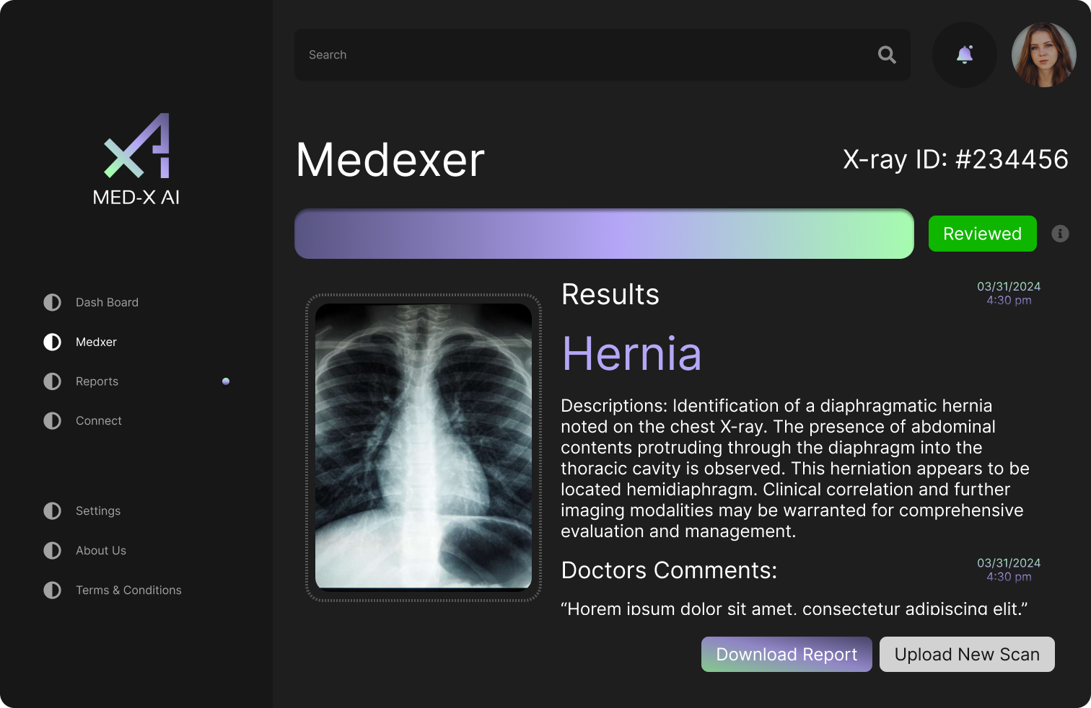
Final Product Design

Slide 19
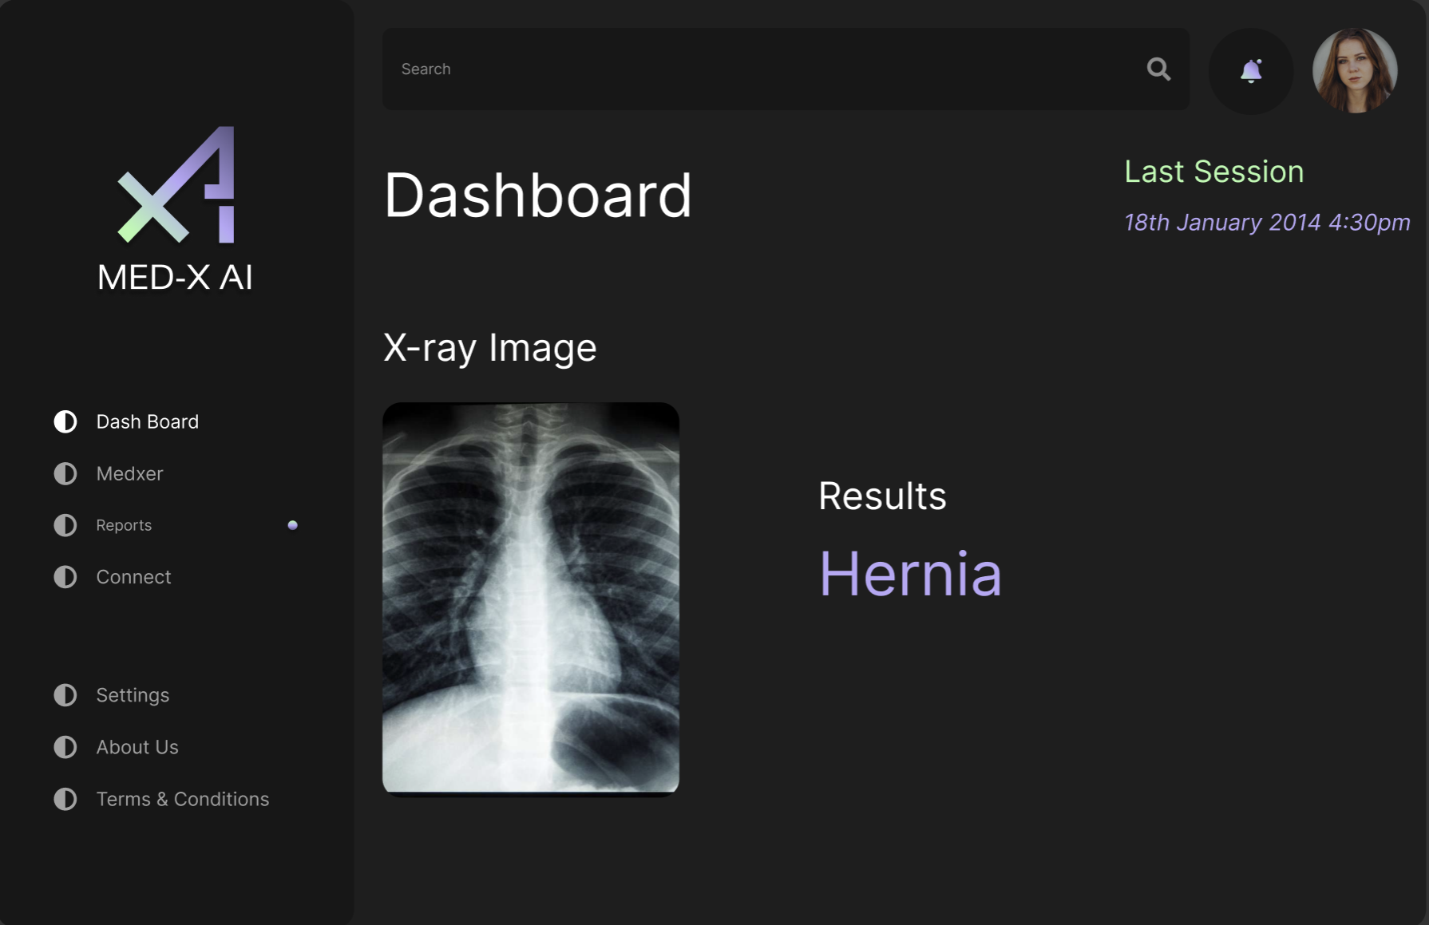
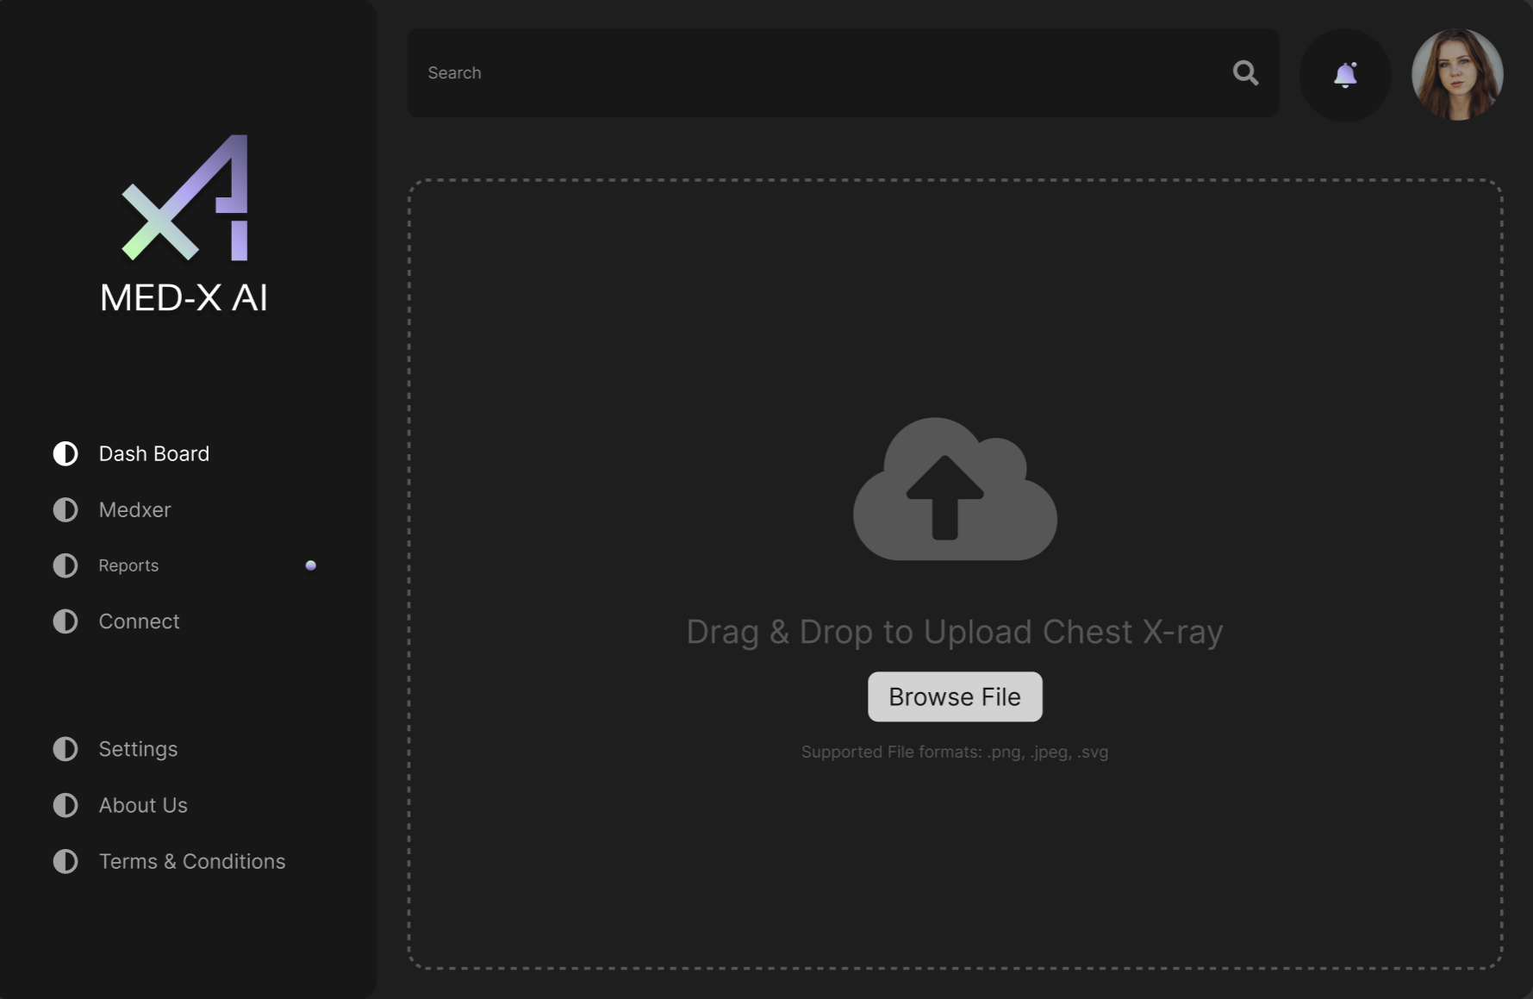
MVP Design

Slide 20
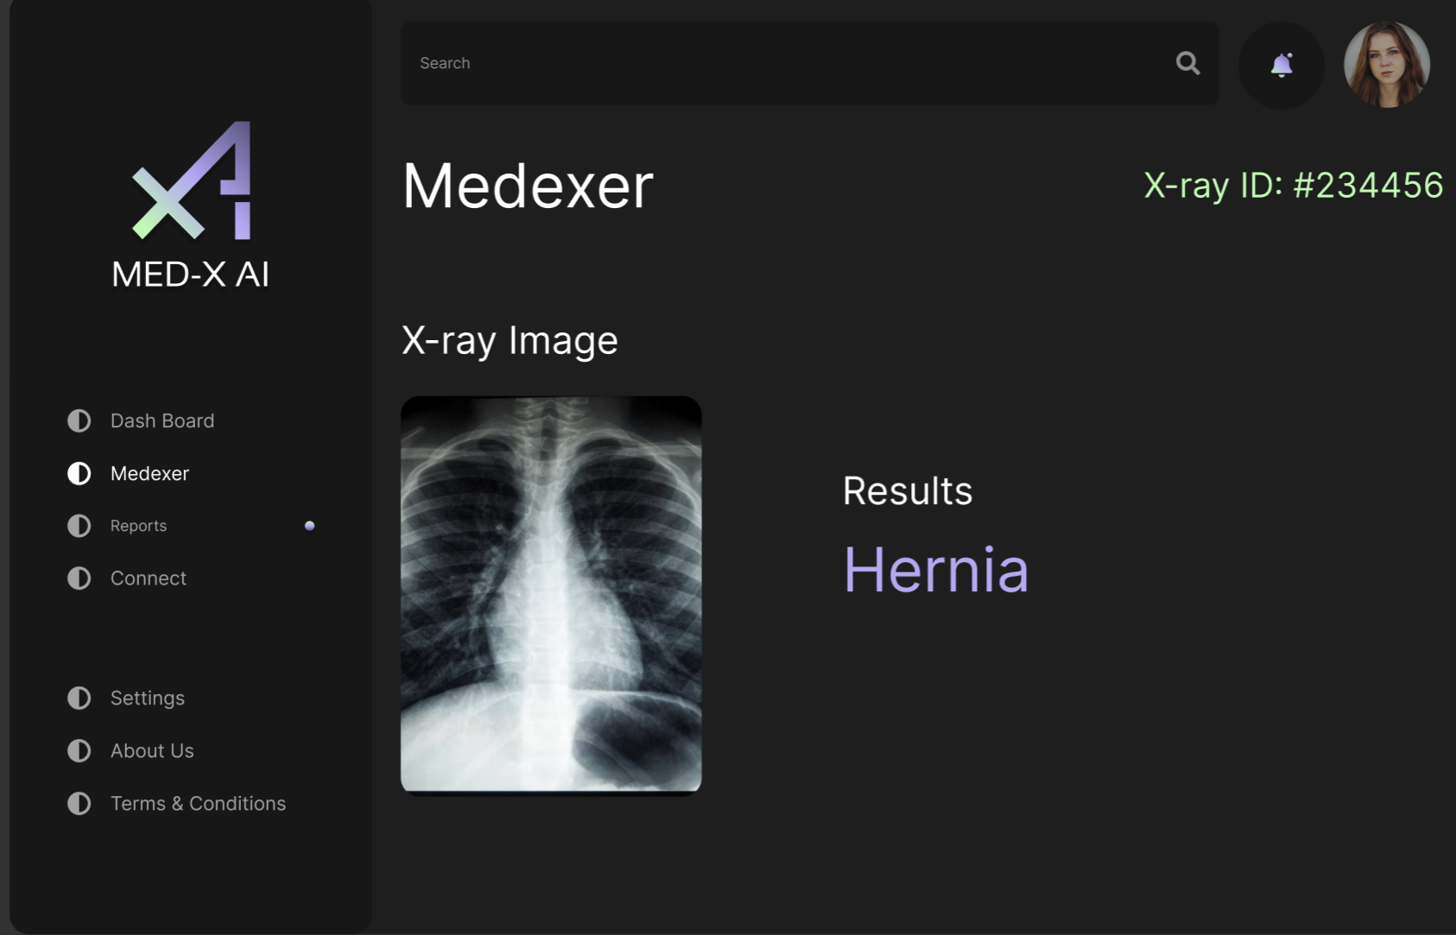
MVP Design

Slide 21


















Technologies & Algorithms
Programming Languages
and Frameworks
Algorithms
Database
Tools
TensorFlow
CNN
Firebase
AWS
Figma
VSCode
HTML5
CSS
JavaScript
Docker
GitHub
React
NodeJS
NestJS
Azure
Python
Tailwind CSS
Postman

Slide 22
Technologies & Algorithms
Programming Languages
and Frameworks
Algorithms
Database
Tools
TensorFlow
CNN
Firebase
AWS
Figma
VSCode
HTML5
CSS
JavaScript
Docker
GitHub
Azure
React
NodeJS
NestJS
Postman
Python
Tailwind CSS

Slide 23
Technologies & Algorithms
Programming Languages
and Frameworks
Algorithms
Database
Tools
Firebase
AWS
Figma
VSCode
HTML5
CSS
JavaScriptt
TensorFlow
CNN
Docker
GitHub
React
NodeJS
NestJS
Azure
Python
Tailwind CSS
Postman

Slide 24
Technologies & Algorithms
Programming Languages
and Frameworks
Algorithms
Database
Tools
TensorFlow
CNN
Figma
VSCode
Firebase
AWS
HTML5
CSS
JavaScriptt
Docker
GitHub
React
NodeJS
NestJS
Azure
Python
Tailwind CSS
Postman

Slide 25
Technologies & Algorithms
Programming Languages
and Frameworks
Algorithms
Database
Tools
TensorFlow
CNN
Firebase
AWS
Figma
VSCode
HTML5
CSS
JavaScriptt
React
NodeJS
NestJS
Azure
Docker
GitHub
Python
Tailwind CSS
Postman

Slide 26
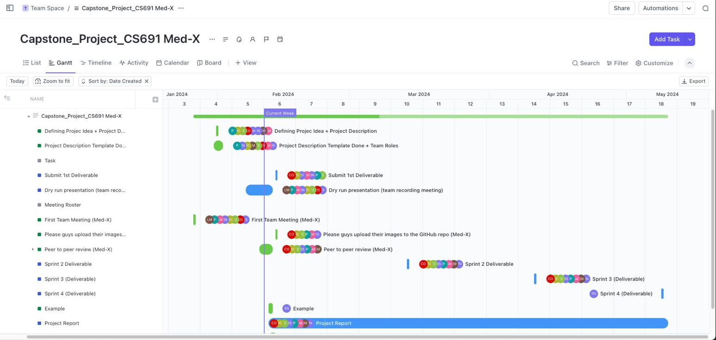
Project Schedule

Slide 27
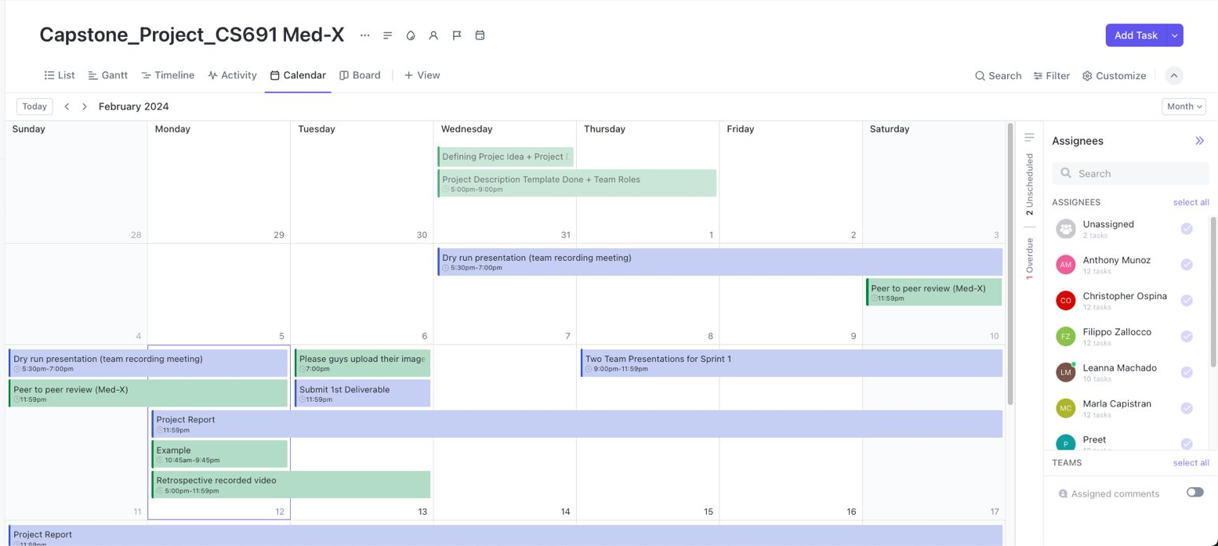
Project Schedule

Slide 28
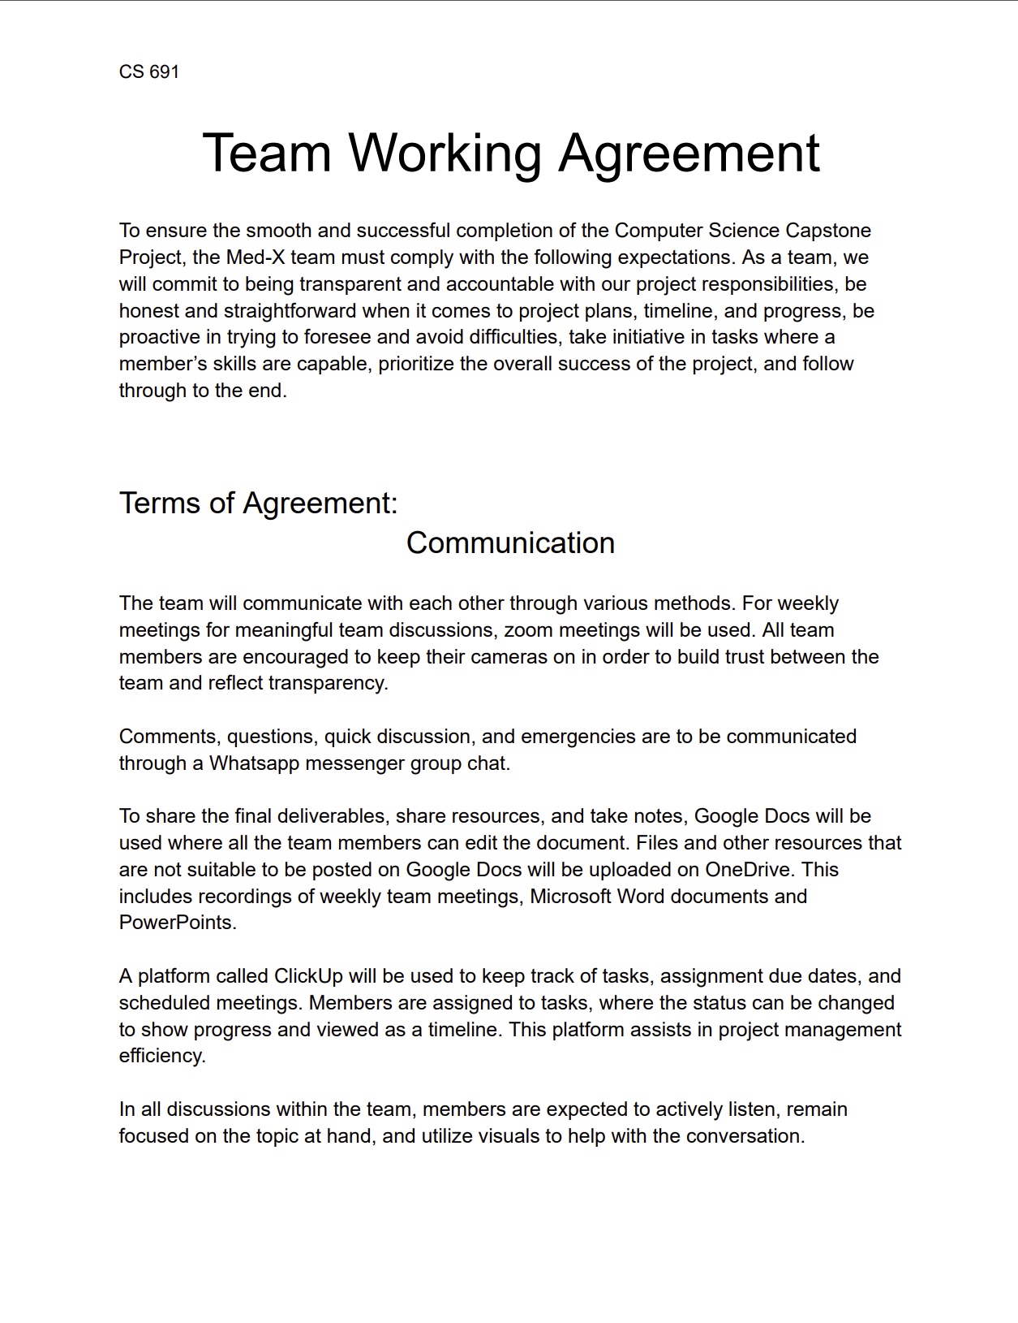
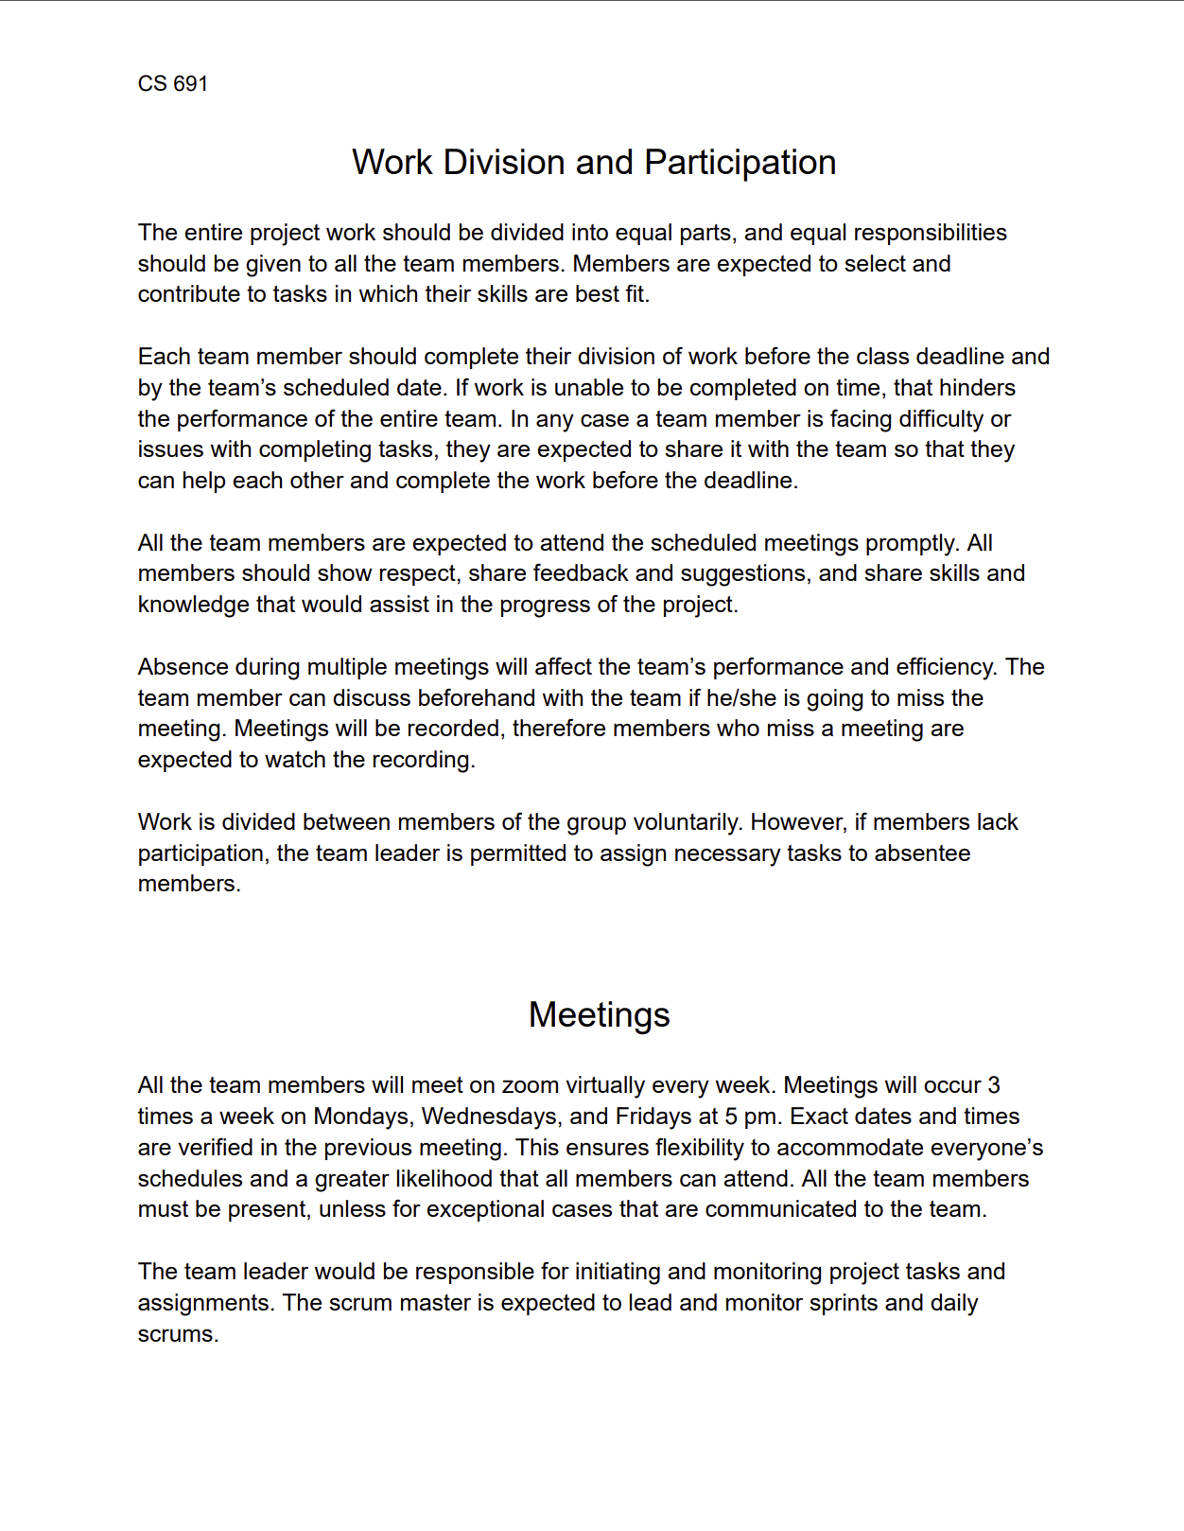
Team Working Agreement

Slide 29
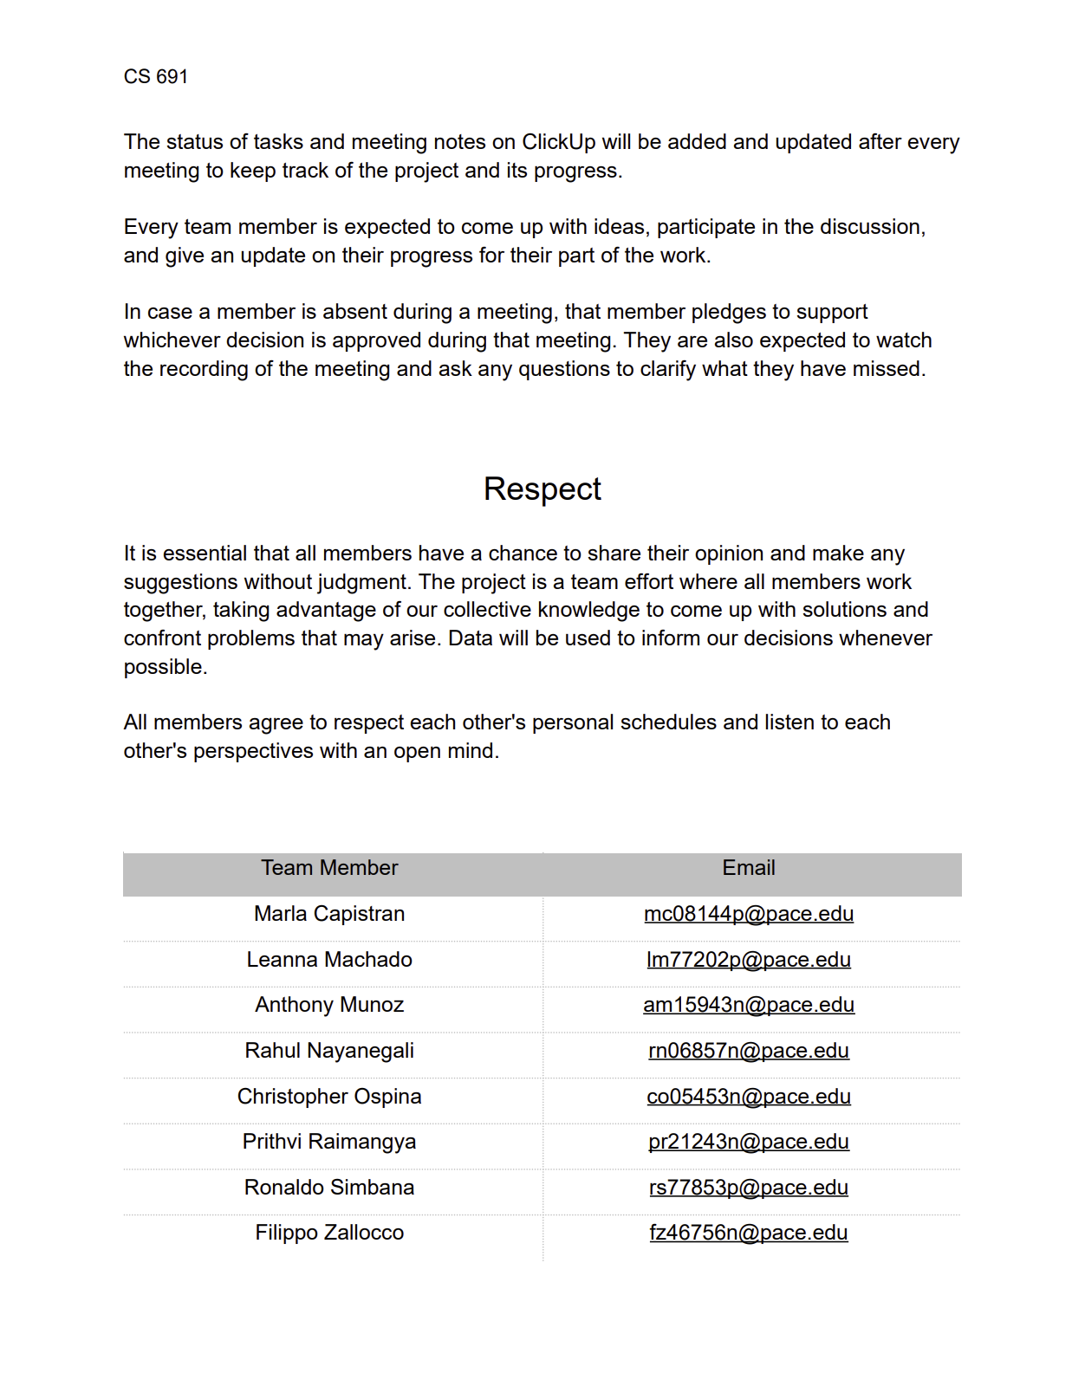
Team Working Agreement

Slide 30
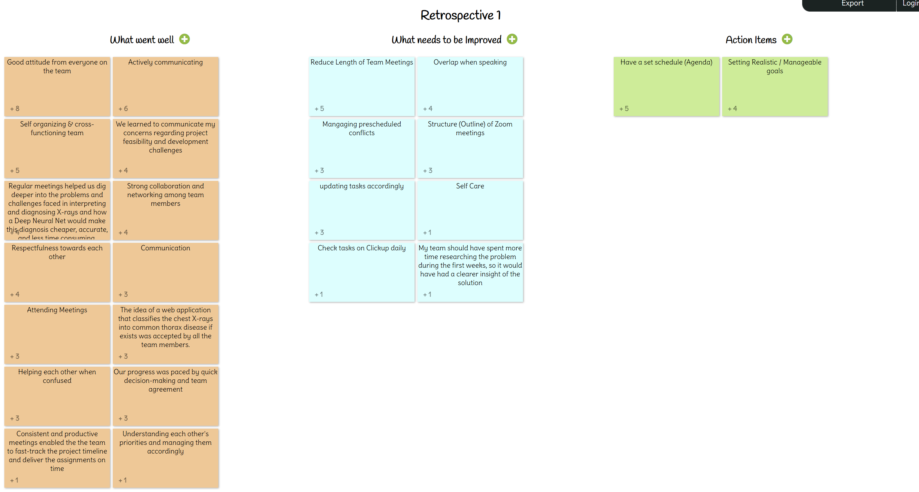
Retrospective:

Slide 31
Retrospective:
What Went
Well
What needs to be Improved
Action
Items
Good attitude from everyone on the team
Actively communicating
Self-organizing and cross-functioning team
Regular meetings
Respectfulness toward each other
Reduce the length of team meetings
Overlap when speaking
Have a structure (outline) for each Zoom meeting
Have a set schedule (Agenda)
Setting Realistic/Manageable goals

Slide 32
Retrospective:
What Went
Well
What needs to be Improved
Action
Items
Good attitude from everyone on the team
Actively communicating
Self-organizing and cross-functioning team
Regular meetings
Respectfulness toward each other
Reduce the length of team meetings
Overlap when speaking
Have a structure (outline) for each Zoom meeting
Have a set schedule (Agenda)
Setting Realistic/Manageable goals

Slide 33
Retrospective:
What Went
Well
What needs to be Improved
Action
Items
Good attitude from everyone on the team
Actively communicating
Self-organizing and cross-functioning team
Regular meetings
Respectfulness toward each other
Reduce the length of team meetings
Overlap when speaking
Have a structure (outline) for each Zoom meeting
Have a set schedule (Agenda)
Setting Realistic/Manageable goals

Slide 34
Retrospective:
What Went
Well
What needs to be Improved
Action
Items
Good attitude from everyone on the team
Actively communicating
Self-organizing and cross-functioning team
Regular meetings
Respectfulness toward each other
Reduce the length of team meetings
Overlap when speaking
Have a structure (outline) for each Zoom meeting
Have a set schedule (Agenda)
Setting Realistic/Manageable goals

Slide 35
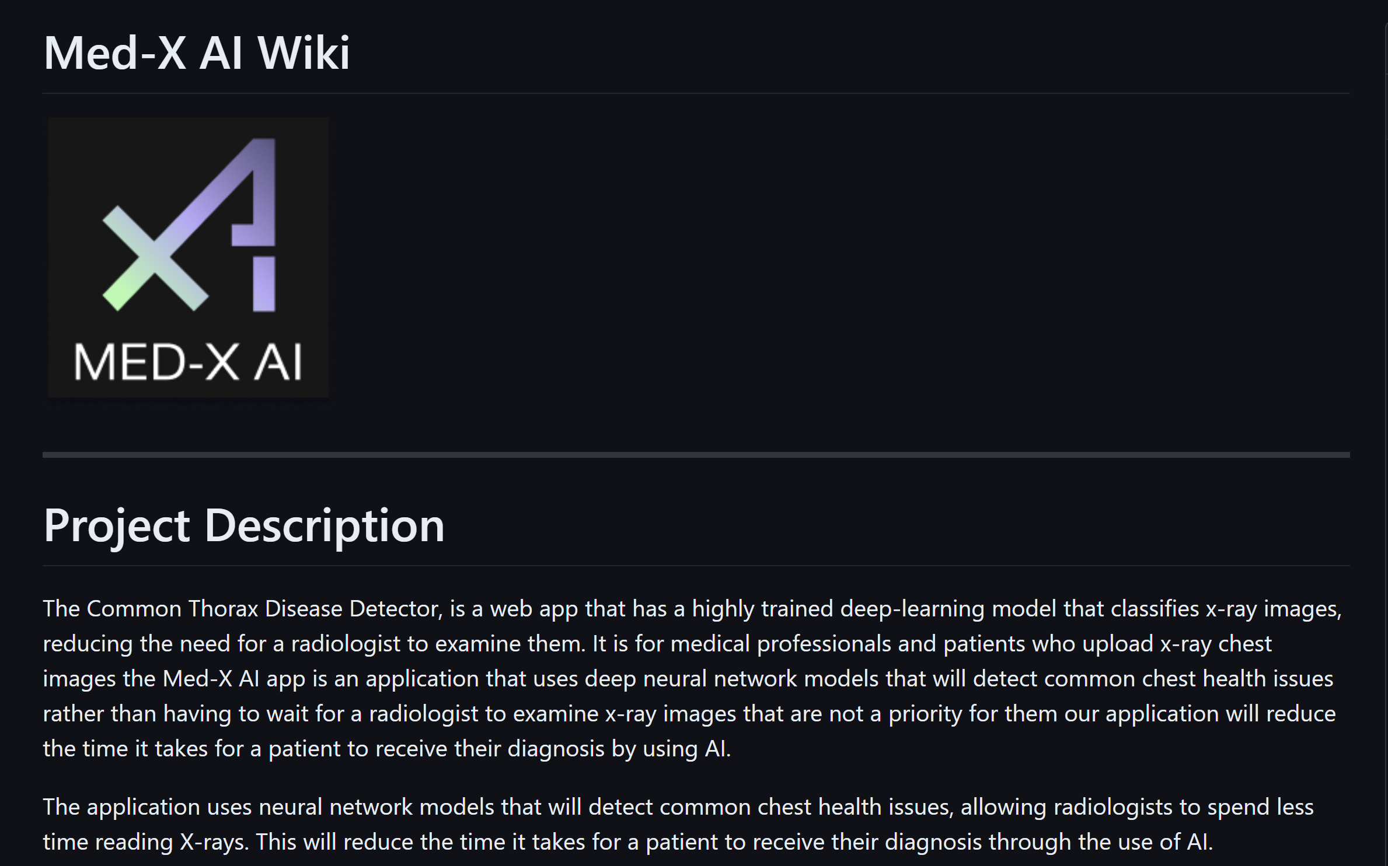
Wikipage Link
https://www.github.com/htmw/2024S-Med-X/wiki

Slide 36
Notes:
Do not delete this slide. It is a part of the animation for the 35th page.

